Slide 1
Project Proposal: The Future of Recycling
Maria Salop
230574

Slide 2
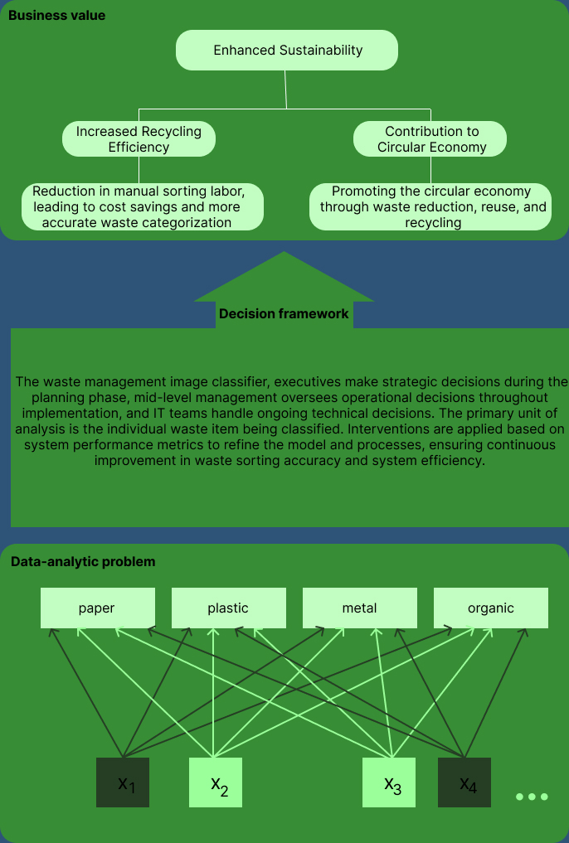
Project Pitch
Business Understanding
Problem Statement
Inefficient waste management and its impact.
High costs and environmental damage due to poor recycling practices.
Main Stakeholder and Needs
Stakeholder: Management.
Needs: Efficiency, cost reduction, sustainability, and regulatory compliance.
EcoScan Application
Real-time waste material classification
Features: Waste image classification, educational content, recycling locator, and community challenges.

Slide 3
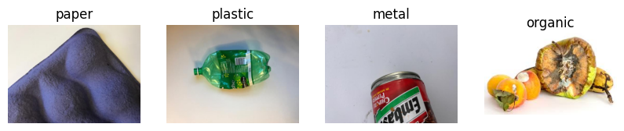
Problem Overview
Deep Learning
The model is designed to classify waste materials into distinct categories for proper recycling.
It has 4 classes:
Paper (182 images)
Plastic (141 images)
Metal (164 images)
Organic (132 images)
The accuracy of the baselines:
Random guess (25%)
Human-level performance (100%)
Basic MLP (32%)

Slide 4
Model Overview
Deep Learning
Development Journey:
Iteration 1: Normalization, CNN with three convolutional layers, CNN, Training accuracy (90%).
Iteration 2: Data Augmentation, CNN with a dense layer with batch normalization and ReLU activation, Training accuracy (90%).
Iteration 3: ImageDataGenerator, CNN TensorFlow's Sequential model framework, Training accuracy (99%)
Iteration 4: VGG16 architecture, pre-trained on ImageNet, Training accuracy (59%)
Performance Breakthroughs:
Data Augmentation: Key for reducing overfitting.
Batch Normalization & Dropout: Stabilized training and further combated overfitting.
Pre-trained VGG16: Significantly enhanced learning capability and accuracy.
Final Model Architecture:
Base: VGG16 (frozen), ensuring rich feature extraction.
Custom Layers: Flatten, Dense(256, ReLU), Dense(128, ReLU) + Dropout(50%), Dense(4, Softmax).
Optimization: Adam optimizer, with Sparse Categorical Crossentropy loss and Accuracy metric.

Slide 5
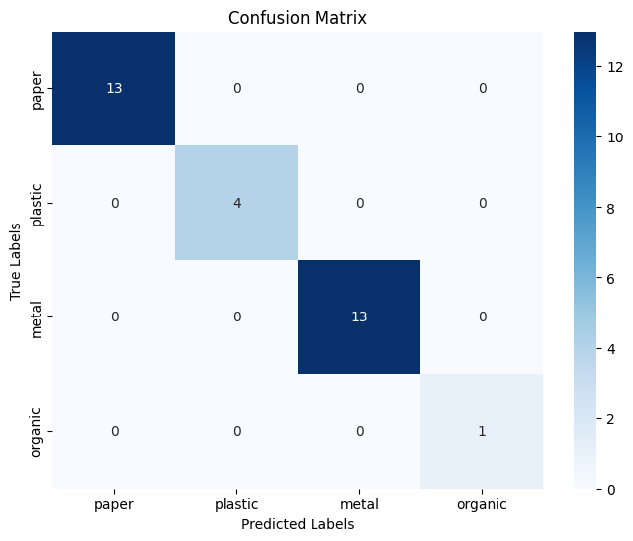
Model Performance
Deep Learning
Final Model Results:
Achieved Training Accuracy: 99.75%;
Validation Accuracy: 69.7%.
x | Accuracy (%) | Precision (%) | Recall (%) | F1 Score (%)
Iteration 1 | 77 | 77 | 76 | 76
Iteration 2 | 31 | 19 | 31 | 23
Iteration 3 | 68 | 69 | 69 | 69
Iteration 4 | 67 | 55 | 61 | 56

Slide 6
Model Interpretability
Responsible AI
Priority: High Accuracy
Essential for correct waste classification.
Direct impact on recycling efficiency and environmental sustainability.
Influences user trust and app adoption.
Secondary: Interpretability
Supports user education on waste segregation.
Enhances user engagement and trust in the app.
Facilitates feedback for continuous improvement.
Balance is Key
Main focus on achieving high accuracy.
Incorporate interpretability to boost user experience and education.

Slide 7
User Study
Human-Centered AI
Study Explanation & Hypotheses:
Conducted a user experience study focusing on app navigation and search functionality.
Hypothesis 1: Simplifying the navigation menu will reduce user frustration and increase task completion speed.
Hypothesis 2: Enhancing search functionality will improve the relevance of search results and user satisfaction.
Incorporation of Results into Final Wireframe Prototype:
Simplified navigation: Reduced the number of menu items and grouped similar functions together for intuitive access.
Enhanced search functionality: Implemented auto-suggestions and filters to allow users to refine their searches more effectively.
Both changes were directly informed by user feedback indicating confusion with the original navigation and dissatisfaction with search results relevance.

Slide 8
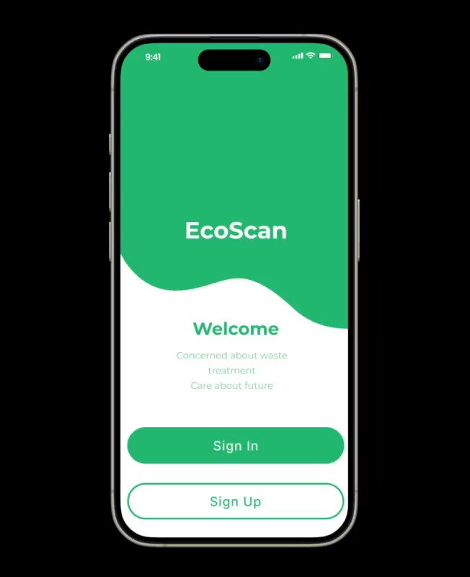
Demo
Human-Centered AI

Slide 9
Thank you!
Any questions?

